Slide 1


General course
2022-2023
Database
ERD
Serhat Erdogan

Slide 2
Goals of this lesson
Student knows what an ERD-schema is.
Student knows what an entity and attribute in a database is.
Student understands the proces of building an database.
Student understands how to make relationships between entities.
Student understand the terms Primary and Foreign Key.
Student can use and understands normalization.

Slide 3
Content table
Database behind the scenes
Proces building a database
ERD-schema
Three levels of data modelling
Basic concepts and terms (Entity, attribute, instance, value, Primary key,…)
Relations between entities (Foreign key, cardinality,…)

Slide 4
Database behind the scenes
Have we ever wondered what goes on behind the scenes when we place an order at bol.com? Bol.com can only function if it keeps track of all the data it collects and stores in a database. But what needs to be kept up to date?
For example, our customer data (name, address, e-mail, bank card or VISA card number…).
All products and related information that we can order online.
But also our orders, their status, whether they have been paid or not, any complaints about an order, the answers of the customer service department to those complaints, return orders, valid vouchers and gift vouchers, reviews on products… and so much more.
Notes:
En dat voor duizenden producten, voor miljoenen klanten en bestellingen. Met andere woorden, dit is niet alleen erg complex, maar ook gigantisch omvangrijk.
Verschillende softwaresystemen ontwikkeld voor bol.com maken gebruik van de data die wordt opgeslagen. Zoals:
• De bol.com website voor klanten (zoals wij).
• De mobile app om bestellingen te plaatsen en op te volgen.
• De helpdesk applicatie, die de helpdesk medewerker gebruikt als de klant belt voor een klacht.
• Business dashboards, waar het management kan zien hoe goed of slecht het gaat, en waar er moet bijgestuurd worden.
Het bouwen van zo’n database is dus al even complex als het bouwen van software.

Slide 5
Process of building a database
The process of building such a database is similar to that of software and consists in a simplified form of the same 3 phases:
Analysis
Design
Implementation

Slide 6
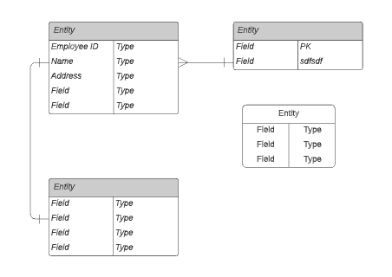
ERD-Schema
An Entity Relationship diagram (ERD) is a visual representation of a database that shows how the elements within it are related to each other. An ER diagram consists of two object types: entities and relationships.
Notes:
https://lucidchart.zendesk.com/hc/nl/articles/207299756-Entiteit-relatiediagrammen

Slide 7
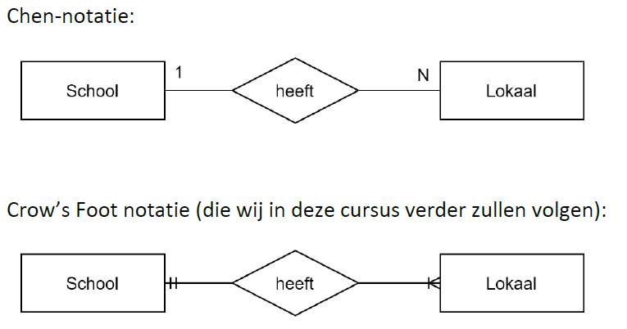
ERD-Schema notations
For ERD there are several standardized variants for noting the scheme. The most famous are the Chen notation and the Crow's Foot notation.

Slide 8
Three levels of datamodelling
In order to move from reality (what bol.com needs in terms of data) to a database, we can draw up the ERD scheme, in which we keep recording more and more details. In this way we speak of:
Conceptual data model (high-level, least details, only entities and relationships)
Logical data model (more details and normalization)
Physical data model (all details, implementation in the database)
Notes:
Het verschil tussen een conceptueel en logisch model kan je vergelijken bij het bouwen van een huis. Als je met de architect gaat samenzitten, heb je wellicht al op papier een ruw schema gemaakt (misschien als tekening op papier) van hoe je huis moet ingedeeld worden. Waar komt de living, de garage, de trap, de vensters…? Dit is eigenlijk een conceptueel model. Het schema dat de architect nadien zal tekenen en met jou zal bespreken, zal uiteraard uitgaan van jouw conceptueel model. Maar er zullen veel meer details aan toegevoegd worden. Waar komen stopcontacten, waar komen de stalen balken om de eerste verdieping te ondersteunen…? Maar opgelet, de kans is groot dat de architect ook enkele wijzigingen aanbrengt aan jouw initieel schema. Omdat hij/zij weet dat sommige zaken later voor problemen kunnen zorgen, of omdat het gewoon beter zal uitkomen bij het bouwen van het huis. Zo kan bijvoorbeeld een binnenmuur op de benedenverdieping iets meer naar links verschoven worden, omdat deze dan precies onder een binnenmuur op de eerste verdieping terechtkomt. Zodat het gewicht van de binnenmuur op de 1e verdieping, ondersteund wordt door de binnenmuur op het gelijkvloers. Dit doet de architect om efficiëntie redenen en het logischerwijs te laten kloppen.

Slide 9
Basic concepts and terms
An (existing) customer opens the website to search for a product. As soon as the customer has found a product and agrees to the price and delivery time, he/she adds the product to the order. If the customer has repeated this for all products he/she wishes, the customer places the order definitively. To place the order, the customer must log in so that the website knows who he/she is. The last step is to make the online payment via a debit or credit card. As soon as the product is delivered, the customer can contact the helpdesk to report a complaint if the product does not work properly.
Notes:
Laat ons de basisbegrippen van ERD uitleggen aan de hand van een vereenvoudigde online webwinkel (bol.com).

Slide 10
Entities
Entities are the main data objects about which information is collected. An entity can be thought of as an object, a concrete (or abstract) "something" such as a person, place, thing or event that is relevant to the database.
Which entities can you extract from the example above?

Slide 11
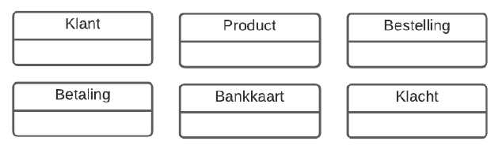
Entities example

Slide 12
Different type of entity
A weak entity only exists by the grace of another entity. For example, the family members of a staff member. If the staff member no longer exists (in the database), the existence of the family members no longer makes sense either. Family members are a weak entity here.
An instance (occurrence) is an individual occurrence of an entity. For example, the customer “Jan Desmet” is an instance of the Customer entity.
Notes:
Hoe herken je entiteiten?
• Entiteiten zijn zelfstandige naamwoorden.

Slide 13
Attributes
Attributes describe the entity (or relationship) they belong to in more detail. They are the properties of the entity (or relationship). For example, a customer can have the attributes First Name, Last Name, Phone Number….
Which attributes can you add to the entities Customer, order and product of the above example?

Slide 14
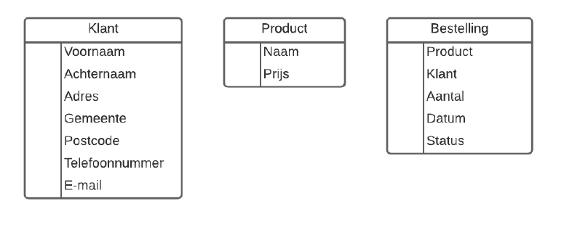
Attributes

Slide 15
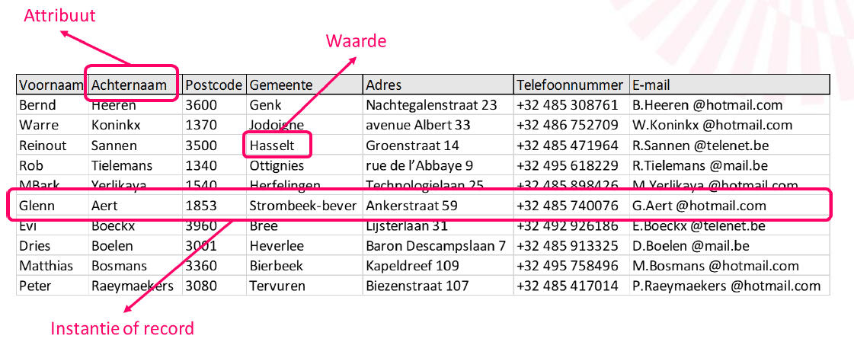
Attribute example
A specific instance of an attribute is a value. For example:
“Peeters” is the value of the Last Name attribute.
“3000” is the value of the Postcode attribute.

Slide 16
Primary Key
When we soon have thousands of customers in our Customer entity, we must be able to identify a customer in an unambiguous way. In other words, we are looking for an attribute that allows us to immediately identify the unique customer. We call this attribute the Primary Key (PK).
The question is which attribute (field) do we use as primary key for a customer?
We cannot use the combination of first name + last name, because it may well be that there are 2 or more customers with the same first and last name.
We can't use the address either, because it may well be that a couple or friends live at the same address. But still separate customers who place orders.

Slide 17
Primary Key
In addition, a PK must meet the following conditions:
The value is unique in the table.
The value cannot be empty.
The value can never change.
An entity has only one PK attribute.

Slide 18
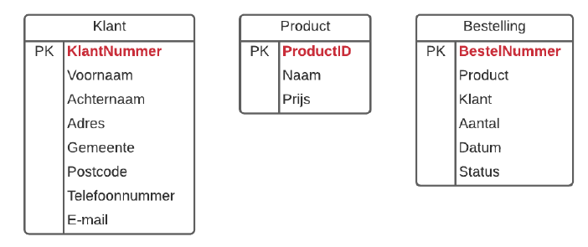
Primary Key
In practice, you will see that customers are often assigned a (to them) meaningless customer number, as soon as they register as a customer or place a first order. That customer number has the exact purpose of being used as a primary key. And it satisfies the three conditions.

Slide 19
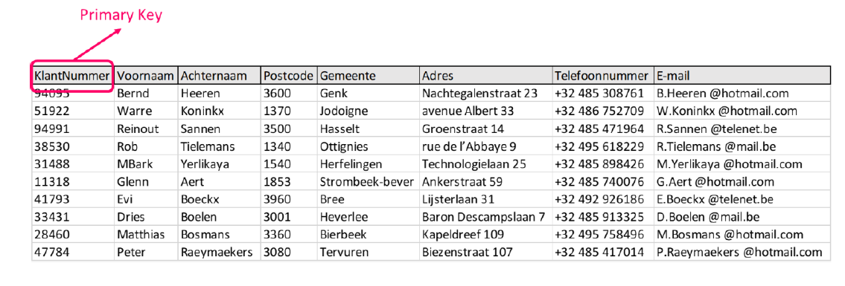
Primary Key

Slide 20
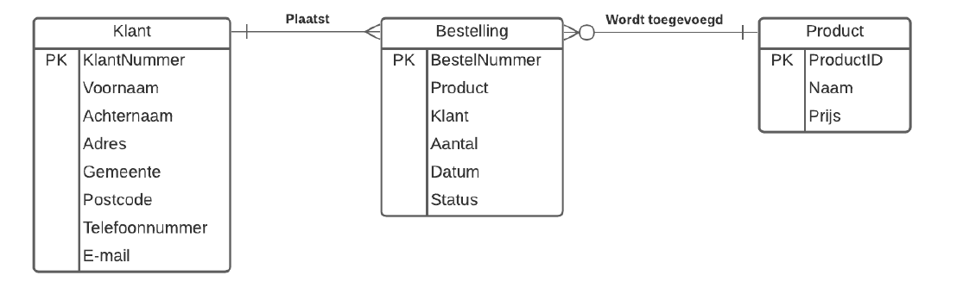
Relations
A relationship represents the relationship between two or more entities.
A customer places an order. “Place” here is the relationship between the customer and order entities.
A product is added to the order.
Notes:
Een relatie wordt voorgesteld door een volle lijn. De vreemde symbolen aan de uiteinden van die lijn, die we in het schema zien, worden later uitgelegd. Vaak wordt ook de naam van de relatie (= het werkwoord) toegevoegd ter verduidelijking. In ons voorbeeld is dat “plaatst” en “wordt toegevoegd”. Uiteraard is de naam van de relatie anders, afhankelijk van de leesrichting.
• Een klant plaatst een bestelling (VLNR) of een bestelling wordt geplaatst door een klant (VRNL)
• Een product wordt toegevoegd aan een bestelling (VLNR) of een bestelling wordt uitgebreid met een product (VRNL).
Soms worden beide werkwoorden toegevoegd. Maar in de meeste gevallen is de andere leesrichting wel duidelijk en wordt dat weggelaten om het schema niet nodeloos complex te maken.

Slide 21
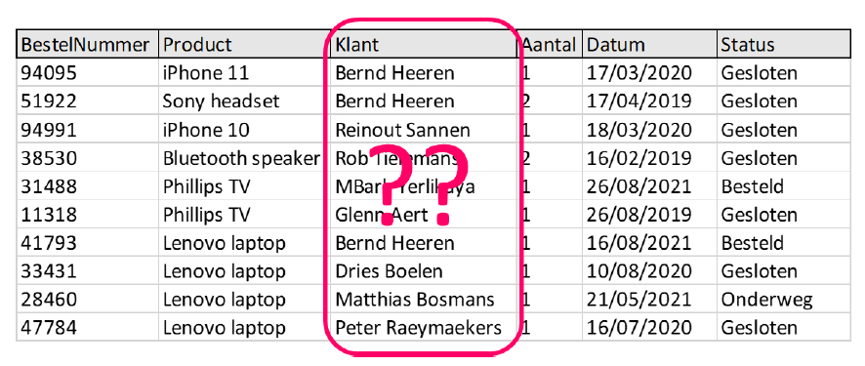
Foreign Key
We now know that there is a relationship between a customer and an order. But how is that link actually made?

Slide 22
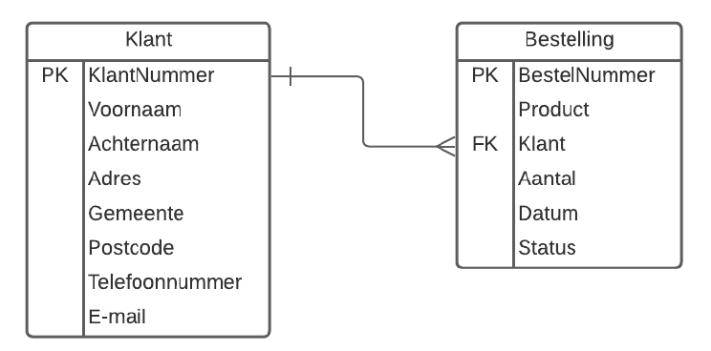
Foreign Key
But the value of that field cannot be just any text (eg a name). Because a small typing error then ensures that the relationship is not correct, and the customer for that order cannot be found. Therefore, it is important that the Customer attribute in the Order entity refers to one and exactly one existing customer (instance) in the Customer entity.

Slide 23
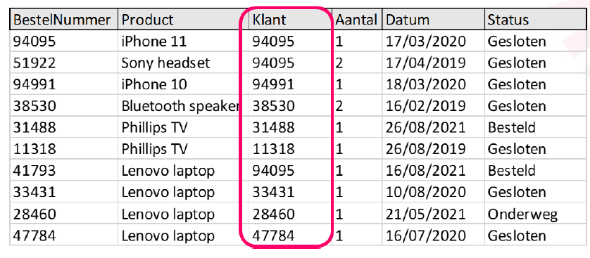
Foreign Key

Slide 24
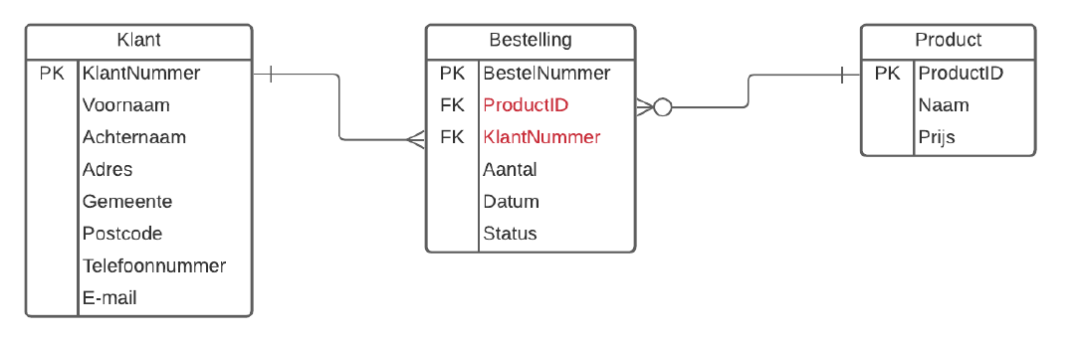
Foreign Key
We call the Customer attribute in the Order entity, the Foreign Key. It contains a value of the PK of a “foreign” entity.

Slide 25
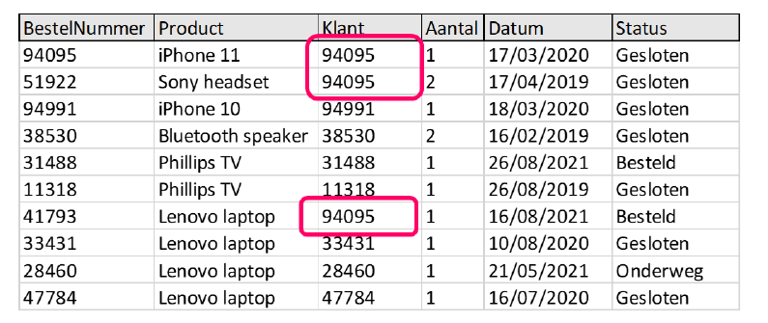
Foreign Key
Important!
Note that an entity can have multiple FK attributes. Order has two FK attributes (CustomerNumber and ProductID).
An FK must NOT be unique. For example, in the Order entity, the same customer number can occur more than once. This, of course, because a customer can place multiple orders.

Slide 26
Foreign Key
Important!
Note that an entity can have multiple FK attributes. Order has two FK attributes (CustomerNumber and ProductID).
An FK must NOT be unique. For example, in the Order entity, the same customer number can occur more than once. This, of course, because a customer can place multiple orders.

Slide 27
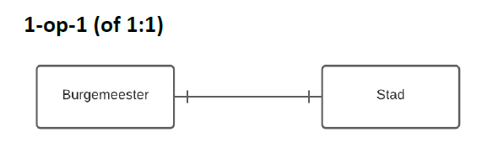
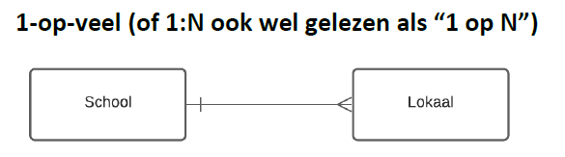
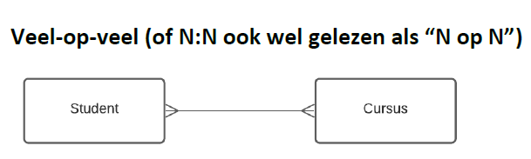
Cardinality
Cardinality describes the maximum number of instances that can participate in the relationship. We have already come across the symbols used in the ERD scheme in previous examples. We speak of a:

Slide 28
Optionality
Optionality is the possibility to indicate whether or not at least 1 instance MUST be present. The symbols we use are
A vertical line (= required 1)
A circle (= optional)
The symbol is placed next to the cardinality symbol. This gives us various possible combinations with which we can indicate exactly what kind of relationship we want to describe.

Slide 29
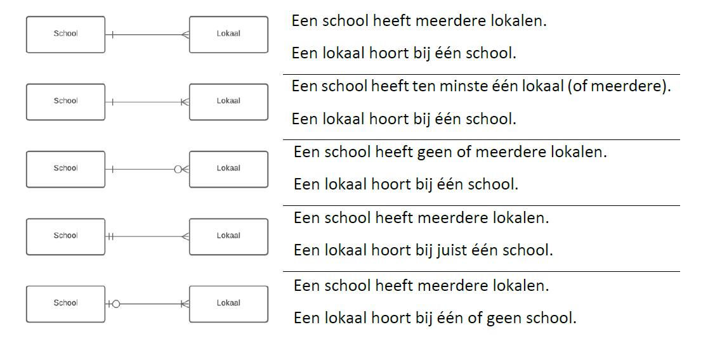
Optionality

Slide 30
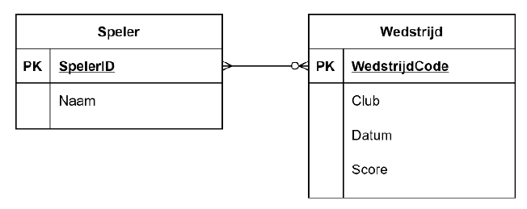
Resolving many-to-many relationships
Two entities: Player and Match
An N:N relationship between Player and Match
A player cannot participate in any, 1 or more matches
A match is played with multiple players
This model is correct in itself. But now it turns out that the physical database we are going to use only supports 1:1 and 1:N relationships. So we cannot use an N:N relationship.

Slide 31
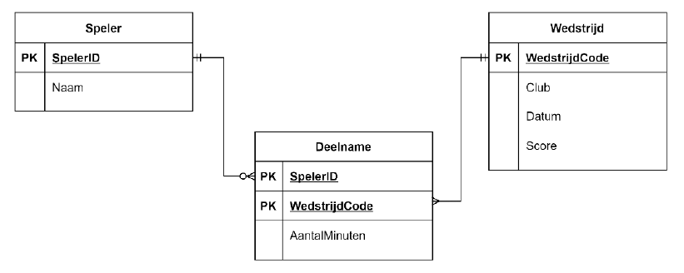
Resolving many-to-many relationships
This can be solved by breaking the relationship with an extra entity: Participation. Each time a 1:N relationship is used.
We can use the combination (PlayerID, MatchCode) as primary key for this new entity.
Notes:
Er zijn ook andere redenen waarom een N:N relatie soms opgesplitst wordt in twee 1:N relaties. Bijvoorbeeld als je aan de relatie extra attributen wilt toevoegen. In ons voorbeeld is dat het aantal minuten dat een speler in een bepaalde wedstrijd heeft gespeeld.
Die informatie kan je NIET kwijt in het ERD schema met de N:N relatie. Want het hoort niet bij de Speler noch bij de Wedstrijd.

Slide 32
Normalization
One of the activities to move towards a logical (and physical) data model is the normalize the data model. Normalization aims (among other things) to make the data model consistent so that no redundant and/or corrupt data can be generated stored. Corrupt data, is the term used for data that is not correct.

